Slide 1
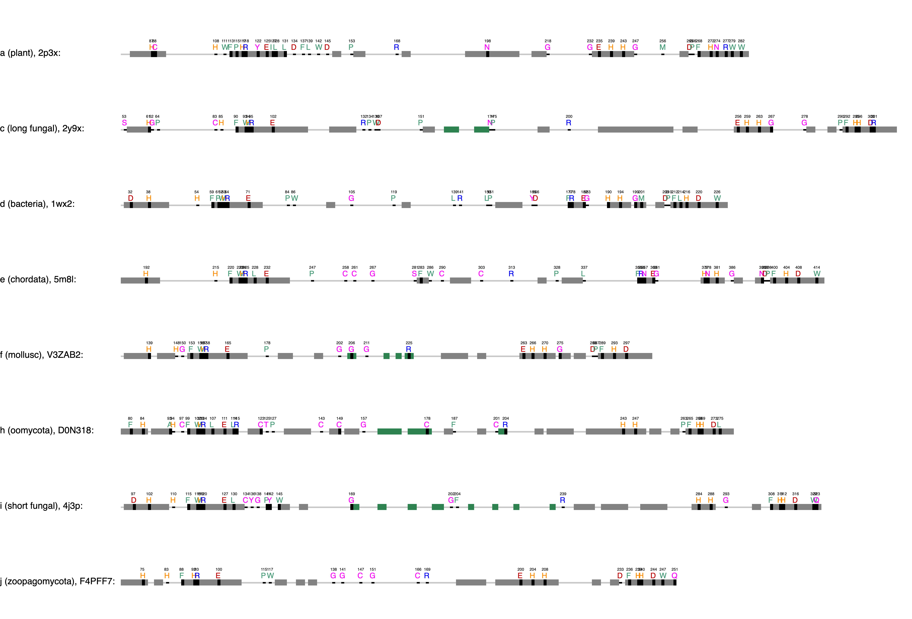
CuA binding motif
CuB binding motif
ppovv
+84
Gatekeeper, F259, 68%, Kampatsikas
Thioether
+62
Blocker residue, Kanteev
+32
+202
+130
First activity controller (HisB₁+1), Kampatsikas
+77
aoco4
+93
+68
The seventh His (HisB₃-1), Kampatsikas

Slide 2
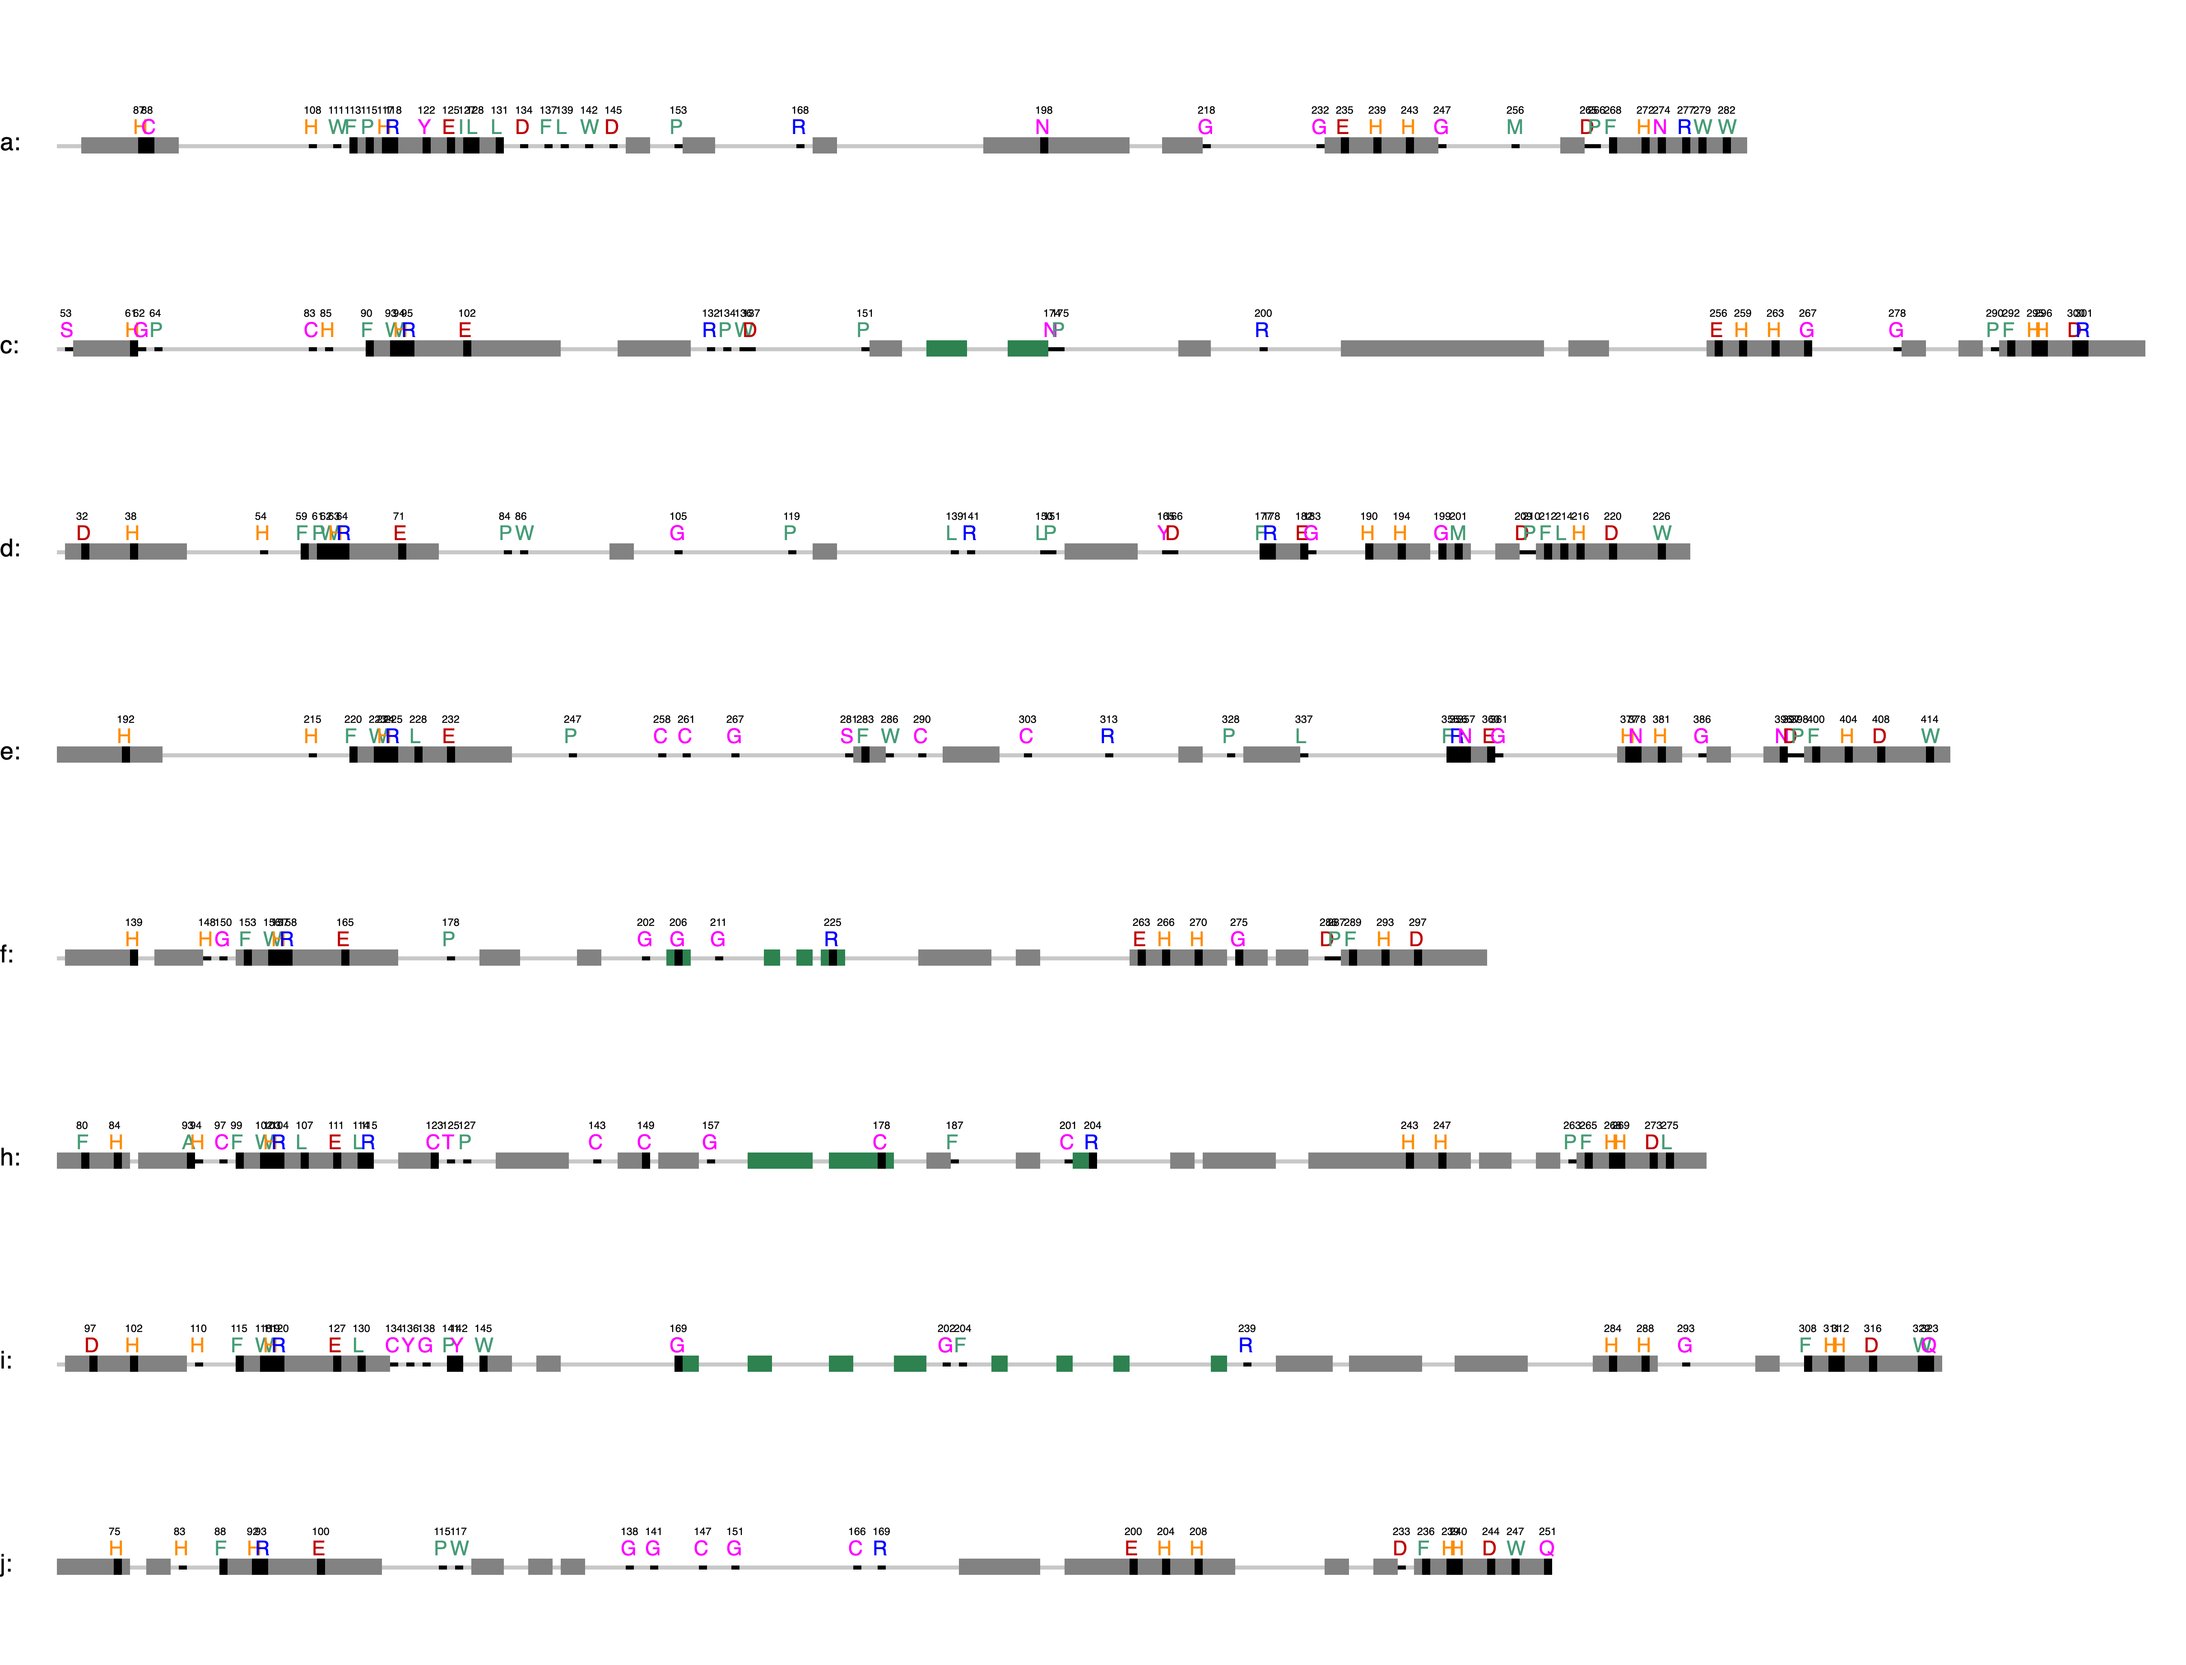
CuA binding motif
CuB binding motif

Slide 3
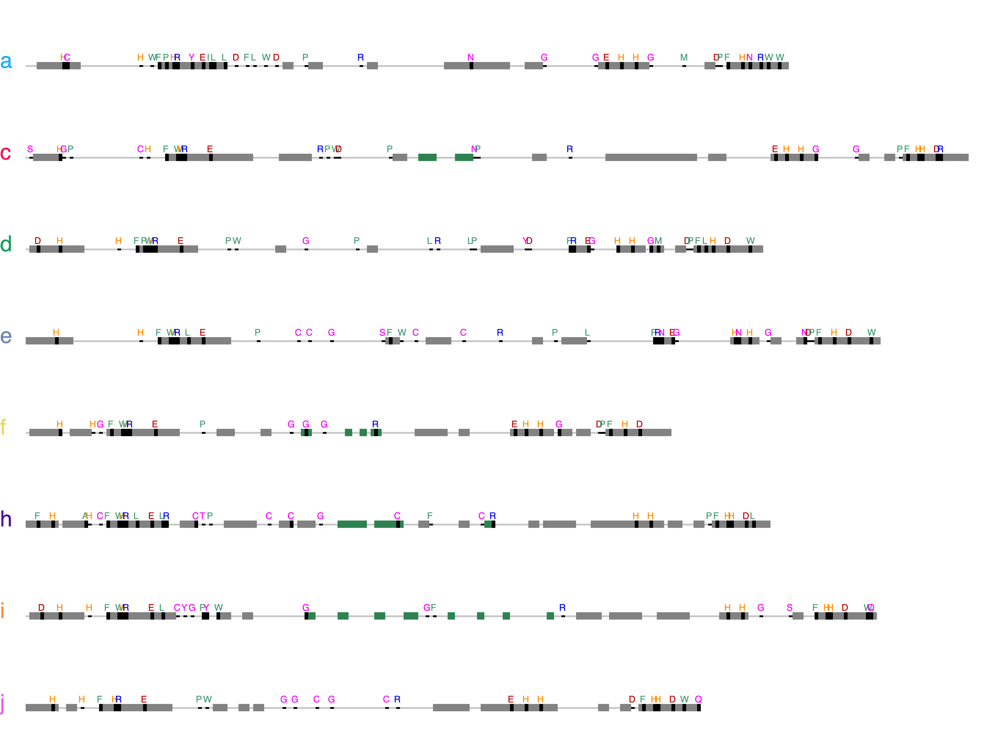
Cu_{A} binding motif
Cu_{B} binding motif

Slide 4

Cu_{A} binding motif
Cu_{B} binding motif

Slide 5
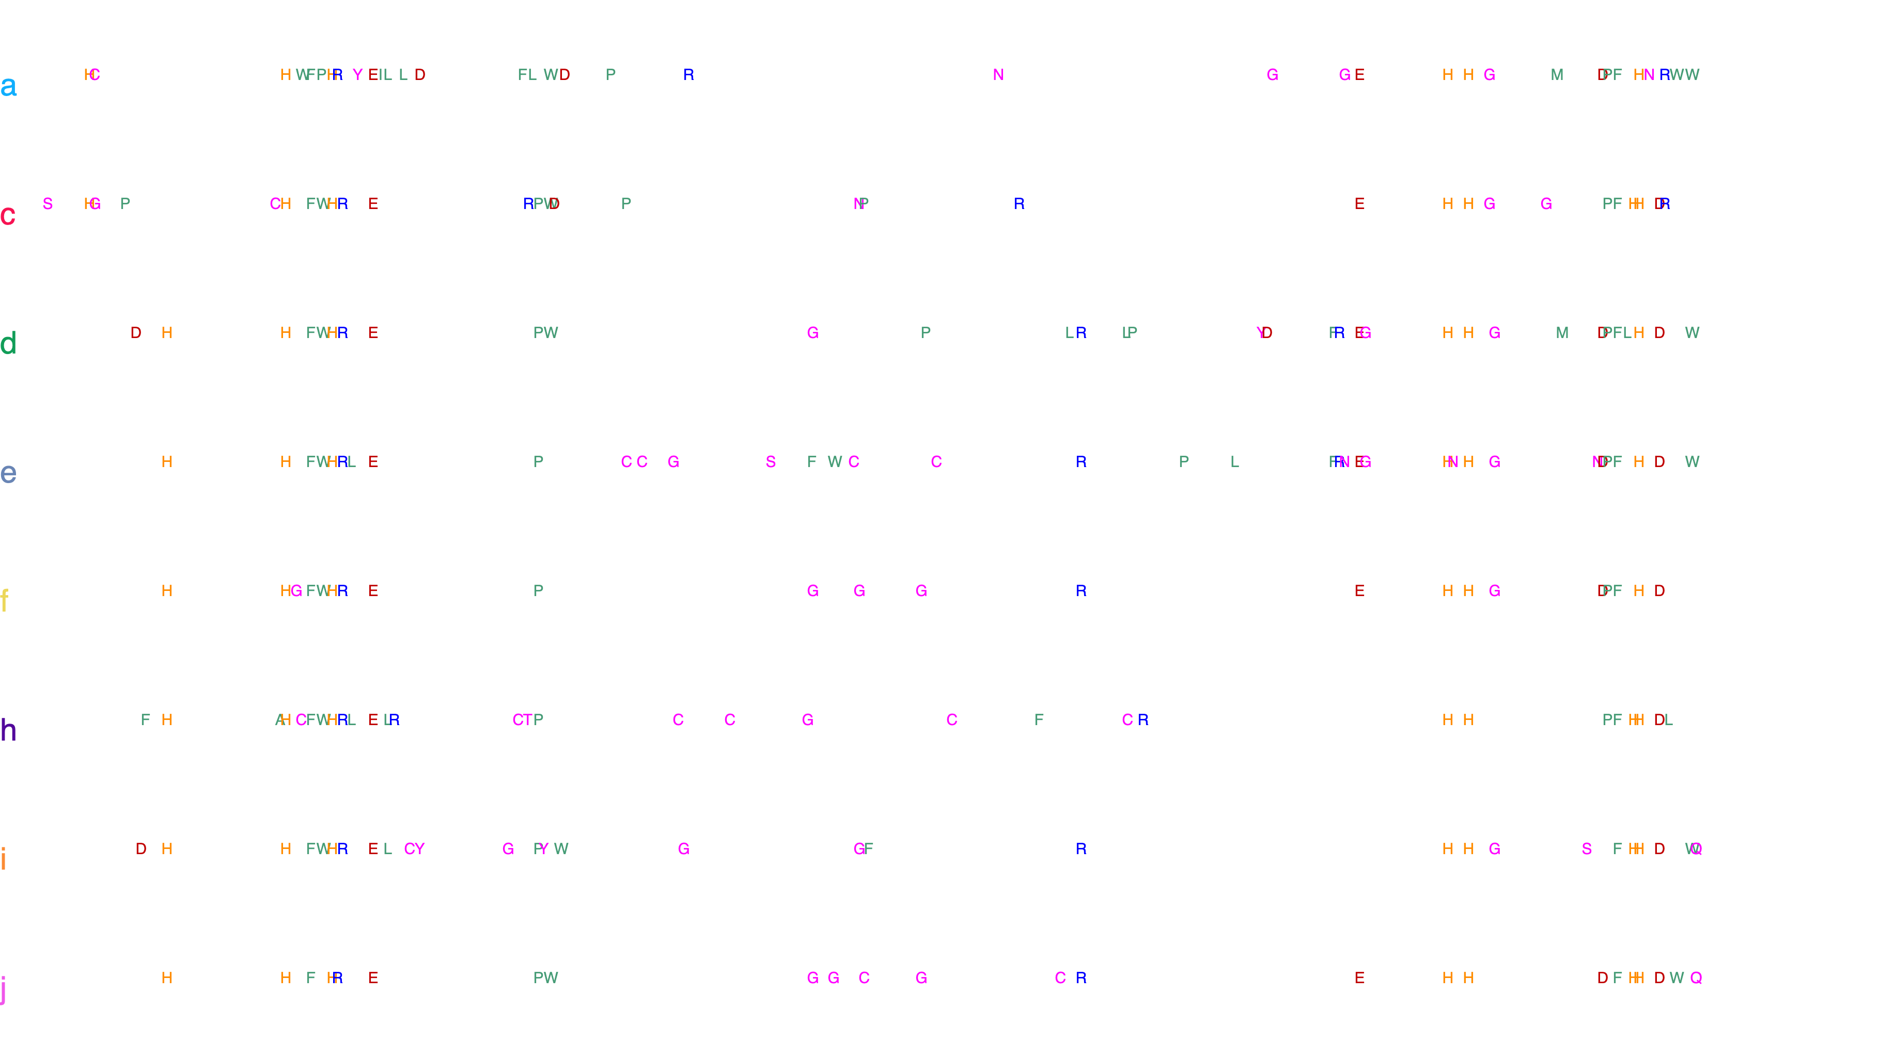
Cu_{A} binding motif
Cu_{B} binding motif

Slide 6

Cu_{A} binding motif
Cu_{B} binding motif

Slide 7
Cu_{A} binding motif
Cu_{B} binding motif

Slide 9
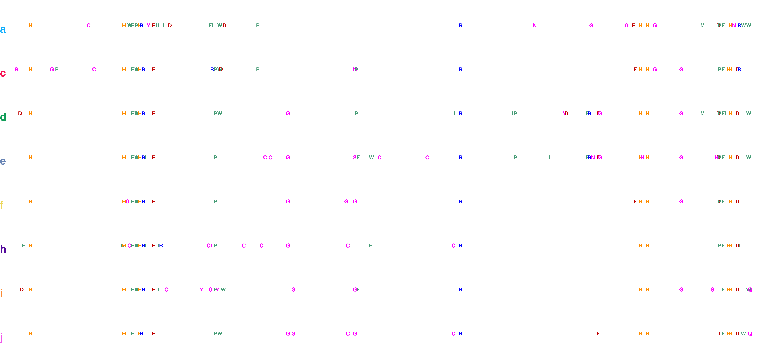
Cu_{A} binding motif
Cu_{B} binding motif

Slide 10
Cu_{A} binding motif
Cu_{B} binding motif

Slide 11
Cu_{A} binding motif
Cu_{B} binding motif

Slide 12
a
b
c
d
e
f
g
h
i
j

Slide 14
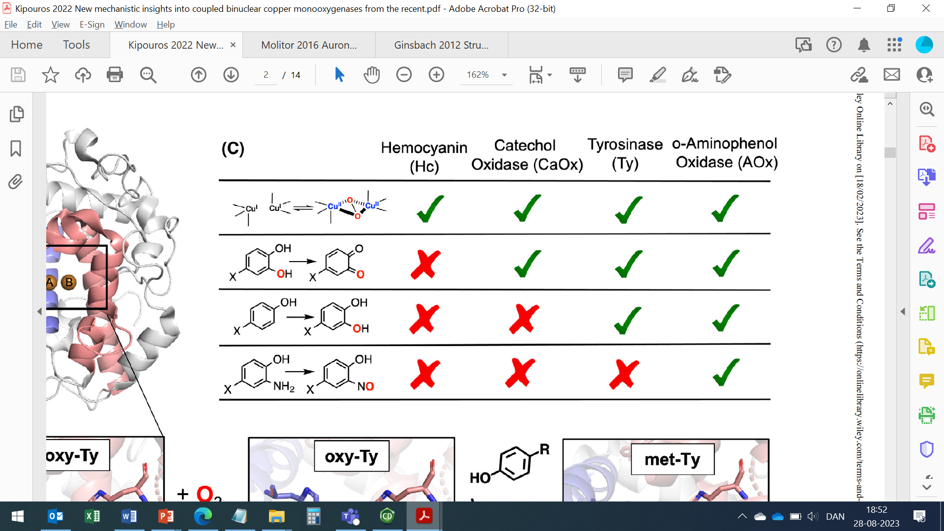
Coupled binuclear copper (CBC) proteins
Hemocyanins
Polyphenol oxidases
O₂ transportation
Tyrosinases
Catechol oxidases
O-Aminophenol oxidase
Monooxygenase + 2 e⁻oxidation
2 e⁻ oxidation
C-nitrosation

Slide 16
Hydroxylation
Gauiacol
Demethoxylation and hydroxylation
Methoxy-ortho-diphenol
Syrringol

